Slide 1
MARKETING CAMPAIGN PERFORMANCE
Prepared by:
Brian Okoth
Rashid Bakari

Slide 2
Objective
To identify expensive underperforming campaigns that should be discontinued.

Slide 3
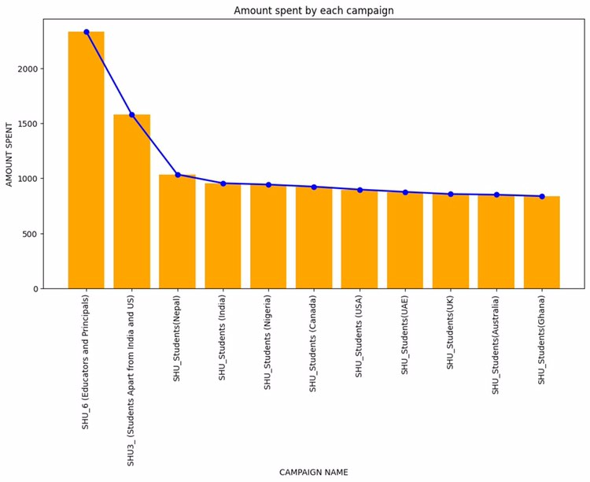
Campaign Performance Analysis

Slide 4
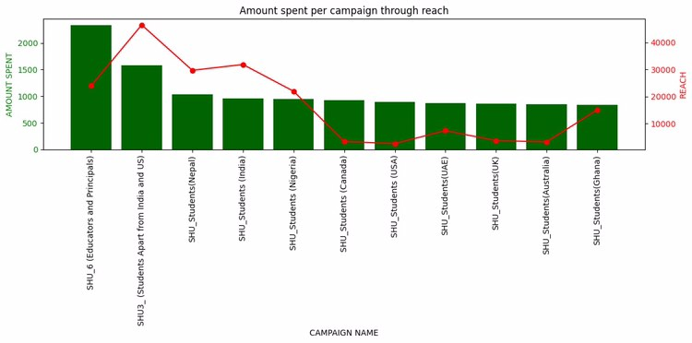

Slide 5
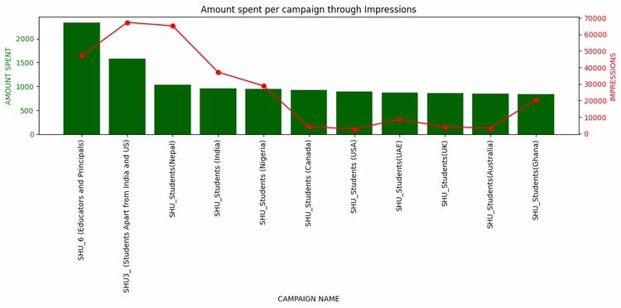

Slide 6
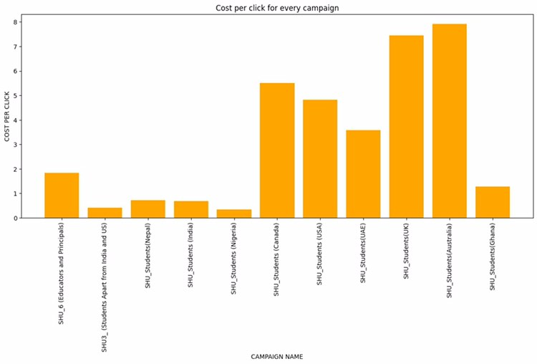

Slide 7
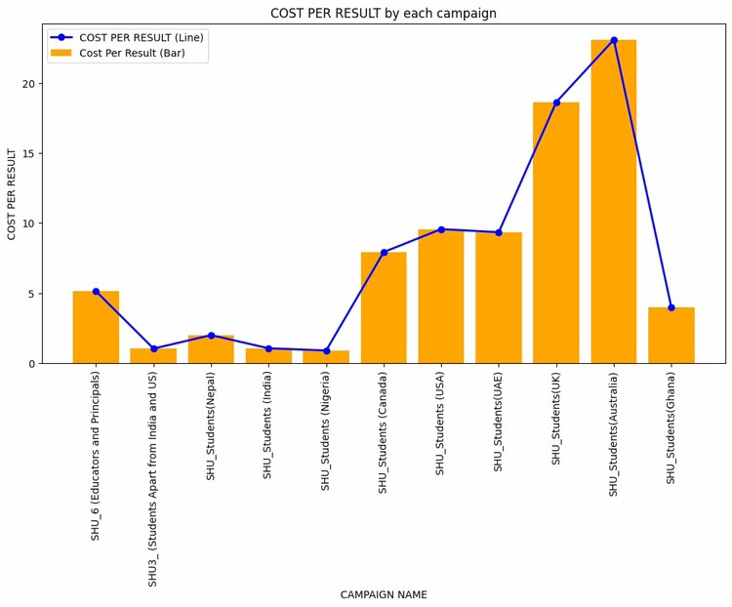

Slide 8
Key Findings
The underperforming campaigns:
SHU_Students(Canada)
SHU_Students(USA)
SHU_Students(UAE)
SHU_Students(UK)
SHU_Students(Australia)
High cost with low reach and number of impressions.
High cost per click and cost per result

Slide 9
Recommendations
Campaign To Discontinue
SHU_Students(UK)
SHU_Students(Australia)
The two campaigns have the highest cost per click and cost per result, with the lowest reach and impressions.

